Slide 1
GES1011/GESS1009
The Evolution of a
Global City-State

Slide 2
listen …

Slide 3
have you used the notion ‘race’ in the last two weeks ?
Yes
No

Slide 4
have you used the notion ‘race’ in the last two days ?
Yes
No

Slide 5
do you think of ‘race’ as a useful category?
Yes
No

Slide 6
do you think of ‘race’ as a scientifically reliable category?
Yes
No

Slide 7
how many ‘races’ are there on this planet?
257
7149
innumerable
i don’t know
1

Slide 8
our task today …
making sense of life and society (demography) in Singapore in the ‘middle’ and ‘latter’ years of British colonialism …
making sense of a human classificatory system …
classificatory system is initially applied …
and then modified, again and again, in response to changing colonial understandings of colonised communities …

Slide 9
our task today …
interpreting Singapore’s past …
reflecting on the continued use of a scientifically discredited classificatory system in 21st century Singapore …

Slide 10
think about it ...
imperialism/colonialism

Slide 11
think about it ...
the effort to conceptualise and isolate so-called main reasons for a 500 year phenomenon ...
even if 200 years ...
possible but improbable ...

Slide 12
think about it ...
sometimes, such efforts stem from efforts or desires to offer clear beginnings, middles and ends to historical unfoldings ...
and over-emphasize ‘original’ motivations and impulses ...
and/or emphasising causality instead of complexity ...

Slide 13
think about it ...
A may influence B ...
but this may only be the beginning, not the end of the story ....
(after some time) B may in turn influence A ...
and (again, after some time and reflection) A influence B ...

Slide 14
think about it ...
A B
A B
A B

Slide 15
think about it ...
the ramifications are potentially endless ...
and the number of imperial contexts numerous ...

Slide 16
think about it ...
appreciate multiple colonial actors: traders, armed forces, capitalists, clergy, convicts ...
appreciate that they were human beings with needs and wants ...
who met other human beings with needs and wants ...

Slide 17
think about it ...
even if in some ways superior technologically with superior canons and guns on swifter vessels ...
the context of their arrival was varied ...
guns without food and water ...
partially capsized vessels ...
dampened gunpowder ...
sickness and unexpected death ...

Slide 18
think about it ...
imperialism/colonialism

Slide 19
Question and Response

Slide 20
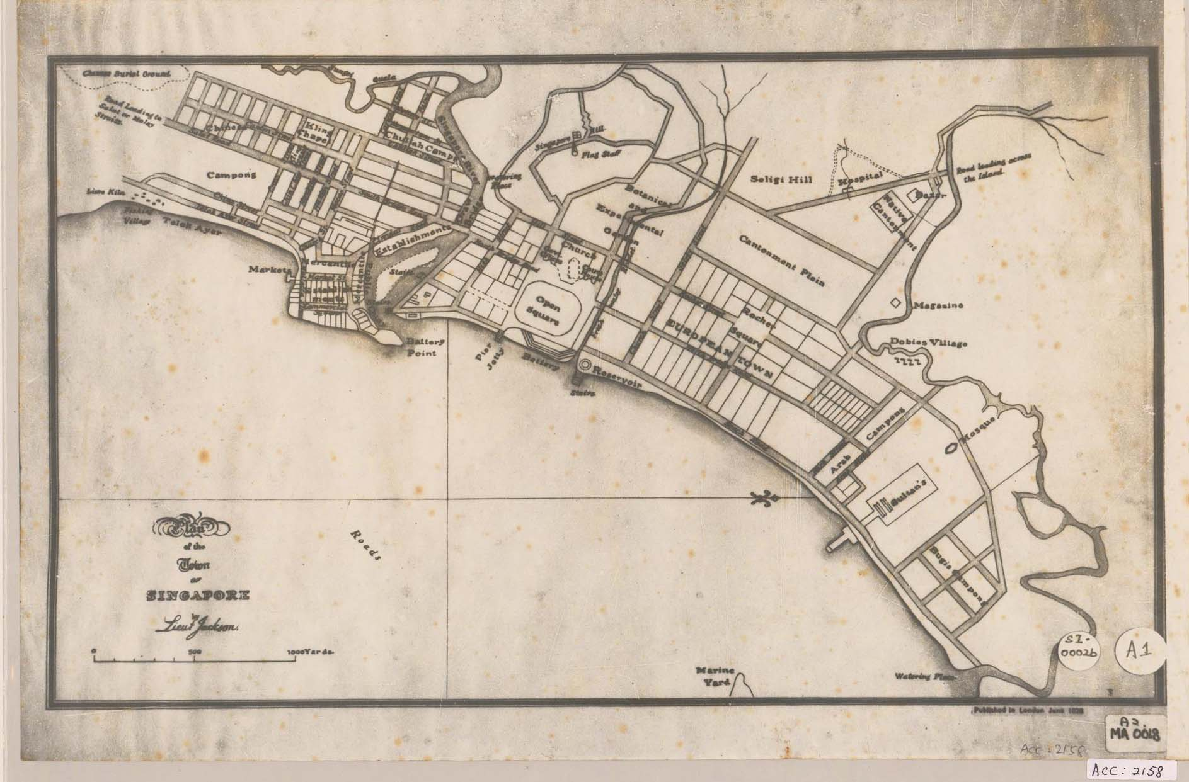
colonial Singapore …

Slide 21
colonial Singapore …
in colonial Singapore …
spaces were carved out early on and designated for various communities …

Slide 22
colonial Singapore …
in 1824, Singapore had about 10,000 residents:
Malays 4,500
Chinese 3,317
the rest: Bugis, Indians and less than a hundred Europeans …

Slide 23
colonial Singapore …
in the early years of British imperialism (in India) …
British presence almost exclusively male …
women and children did not accompany spouse for various reasons …
more important of which were: climate, hygiene, disease and arduous journey ...

Slide 24
early 1800s

Slide 25
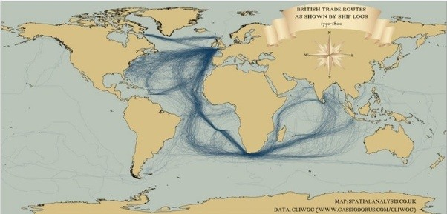
colonial Singapore …

Slide 26
1830

Slide 27
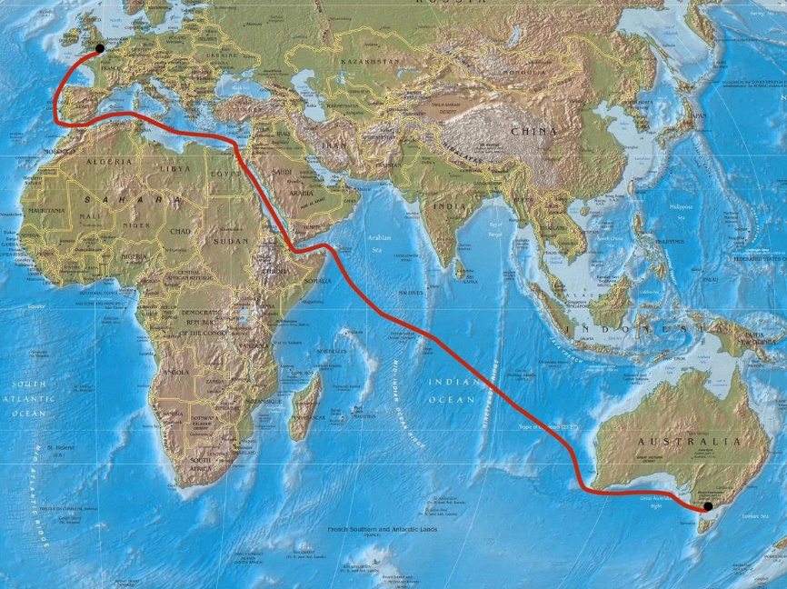
colonial Singapore (Overland Route) …

Slide 28
colonial Singapore …
the connection across the Middle East was suitable only for passengers and mail …
only possible after the invention of steam ...
there was an awkward trip by horse-drawn wagon 84 miles across the desert from Suez to Cairo …
down the Nile in a tiny paddle steamer …
and then transit by barge on the Mahmoudieh Canal to the Mediterranean port of Alexandria …

Slide 29
colonial Singapore …
the whole journey was first described as the Steam Route …
later, and more generally, it became known as the Overland Route …
journey time reduced from six to two months (to India) …
originally another two to three to Singapore ...

Slide 30
1869

Slide 31
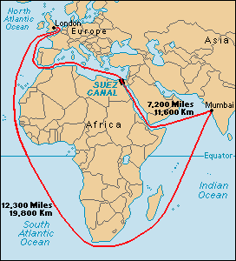
colonial Singapore …

Slide 32
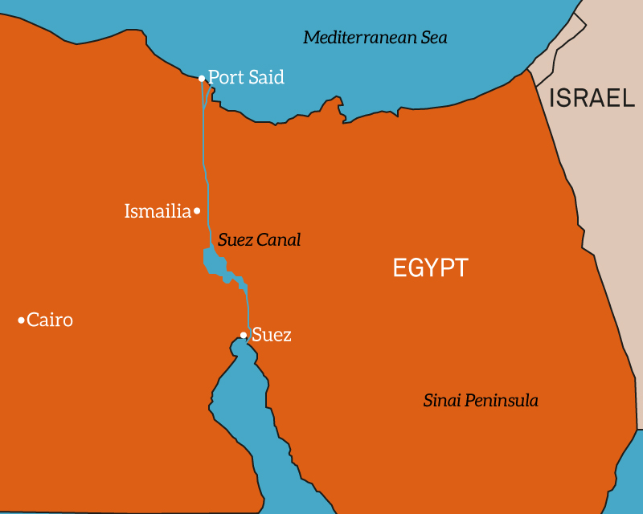
colonial Singapore …

Slide 33
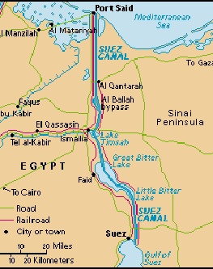
colonial Singapore …

Slide 34
colonial Singapore …
1850s … compound steam engine …
submarine cables …
1869 .. Suez Canal opened …
1880s … refrigeration …
1914 … three weeks from London to Bombay

Slide 35
colonial Singapore …
European social life in the colonies (like Singapore) began to change …
more women and families arrived ...
communication (telegraph and snail mail) enhanced …

Slide 36
colonial Singapore …
contact with homeland through regular furlough and leave …
refrigeration and relative speed of transport brought more ‘home products’ into Singapore …
making life in the tropics much more bearable, if not appealing …

Slide 37
colonial Singapore …
with intra-European ties strengthened and enhanced …
contact with others, even English-speaking others, become more dispensable …
this had a relatively strong effect on European and non-Europeans ties …
making non-Europeans more aware of their ‘secondary’ status …

Slide 38
Question and Response

Slide 39
race and colonial Singapore …
imperialism was a complex multi-faceted beast …
besides its much-touted technological facet …
allowing for geo-political and economic control …
there was a cultural - epistemological (scientific and social scientific) dimension …

Slide 40
race and colonial Singapore …
European scientific obsession in classifying and describing the natural world and its inhabitants …
fauna
flora
weather
food
culture: language, writing, music, tool-making, financing, land-holding, etc.
people groups (inhabitants)

Slide 41
race and colonial Singapore …
European ‘intellectuals’/’scientists’ were attempting to extend the Linnean classificatory system of zoological types of the phenotypical variation of humankind …
the meaning "race" began to shift from a relatively general term that distinguished peoples on almost any criteria
to a narrower classification of biologically defined subspecies …
with specific assumptions about the inheritability of cultural predispositions and the potential for progress …

Slide 42
race and colonial Singapore …
these ideas were given a significant scientific standing (later discredited) with the application of evolutionary theory to the origins of the different races …
as opposed to the earlier era of multiple explanations of human diversity, the racial theory of innate differences initially encountered little dissent in the Western world …

Slide 43
race and colonial Singapore …
Darwin, Wallace, Huxley, Spencer, and virtually all evolutionists of the late nineteenth century regarded racial differences as essential to the understanding of human behaviour …

Slide 44
race and colonial Singapore …
ethnology (eventually subsumed under anthropology) … pioneered approaches in interpreting the data on human differences
cultural and physiological differences …
cultural differences: language, dress, food, birth and death rituals, health and hygiene, etc.

Slide 45
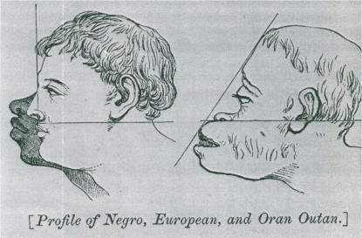
race and colonial Singapore
physiological differences: shape and size of body parts (particularly head), colour of skin and eyes, type of hair, etc. …
at this point, nothing particularly objectionable …

Slide 46
race and colonial Singapore
the trouble begins when some quarters leveraged on the idea that the latter were inherent and immutable differences (Hirschmann reading) …
these were labelled “racial” differences …

Slide 47
race and colonial Singapore …
these physiological differences …
in light of specific interpretations of evolutionary sciences …
and aided in part by growing technological lag between colonizing and colonised societies …
and also the variety of spurious defences used to resist the abolitionists …

Slide 48
race and colonial Singapore …
these differences came to be used to suggest the existence of superior and inferior races …

Slide 49
race and colonial Singapore …

Slide 50
race and colonial Singapore …
such ideas had been discredited as pseudo-science since the 19th century …
but by then their influence was established and continued unabated … the power of bad ideas ???
by the middle of the 20th century, we have the 1951 United Nations statement …

Slide 51
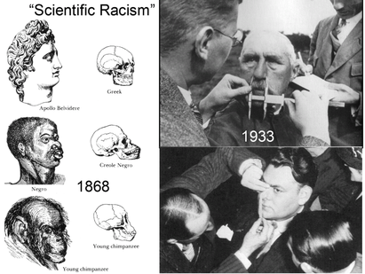
race and colonial Singapore …

Slide 52
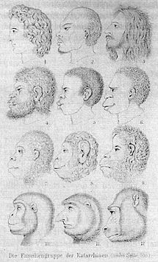
race and colonial Singapore …

Slide 53
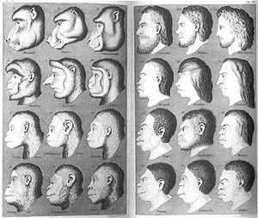
race and colonial Singapore …

Slide 54
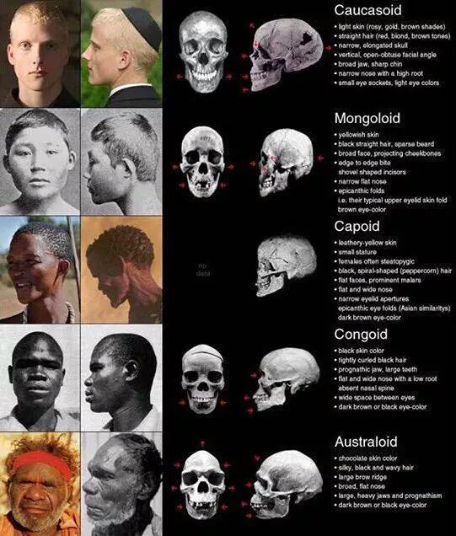
race and colonial Singapore …

Slide 55
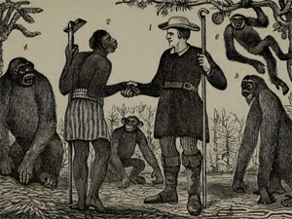
race and colonial Singapore* …

Slide 56
race and colonial Singapore …
hey cousin !!!

Slide 57
race and colonial Singapore …
European theories on racial differences take hold in Singapore …
creating cleavages in colonial society between Europeans and the others …
a de facto social hierarchy/civilizational ladder seemingly emerges as seen in a series of censuses …

Slide 58
Question and Response

Slide 59
imperial legacies …
emerges in a colonial context …
reflective of a new but discredited epistemology …
the legacy of a discredited idea that lives on in contemporary Singapore …
and is prevalent in much of contemporary and historical discourse of the nation-state of Singapore …

Slide 60
past and present*
do you think ‘race’ has a continuing relevance today?
should Singapore keep it or ditch it?
how many of you still refer to Pluto as a planet (even if you are not from science or physics)?

Slide 61
Tutorial 4
this Friday and next Monday …
for Friday’s tutorials, please complete Tutorial 3 forum posts by tomorrow …
For Monday’s groups, please do so by Friday …

Slide 62
Question and Response

Slide 63
colonial legacies …
watch …

Slide 64
Question and Response

